Slide 1
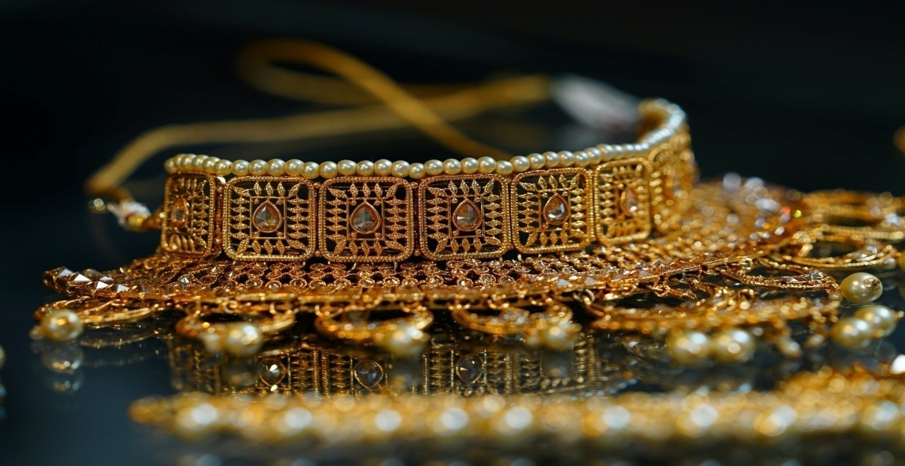
ONLINE JEWELLERY SHOP Tanishq jewellery

Slide 2
Project Profile
Project title:- | Tanishq jewellery shop
Objective:- | To provide online informationfrom anywhere & anytime
Front-end tool:- | Php
Back-end tool:- | My sql server
Platform:- | Web site
OS platform:- | Windows 11
Supportive tools:- | MS Office 2007
Developed by:- | Surkar Jaimini Chaudhari Jyotsna
External guide:- | Mr.Minesh chaudhari

Slide 3
INTRODUTION
We have developed the website “Tanishq jewellery” for “Home Project”.
Tanishq jewellery is an online jewellery store that houses high quality jewellery with strikingly exquisite designs. With its affordable rates and unique shopping experience, Bluestone is your one stop destination for making any given day an occasion.
That's precisely what you can expect at Tanishq.com. An online jewellery store that's positioned to cater to stylish men and women, Tanishq houses exquisite pieces of jewellery, designed to appeal to people with unique tastes.
Tanishq jewellery aims at revolutionizing the Jewellery and Lifestyle Ecommerce scene in India with its firm focus on affordability, quality and user experience.

Slide 4
HARDWARE & SOFTWARE REQUIREMENT
HARDWARE REQUIREMENT
Server Side : Hard Disk Drive 1 TB
RAM 8 GB Higher
Processor Intel(R) Core(TM) i5-8350U CPU @ 1.70GHz 1.90
GHz
Client Side: Hard Disk Drive 32 GB OR Higher
RAM 4 GB Higher

Slide 5
SOFTWARE REQUIREMENT
Server Side : Software Notpad++, vs code
Operating System Windows 11 pro
Front end HTML, PHP, Css, Javascript
Back end My SQL, PHP
Client Side: Software Any browser
Operating system Window 7,Android and above

Slide 6
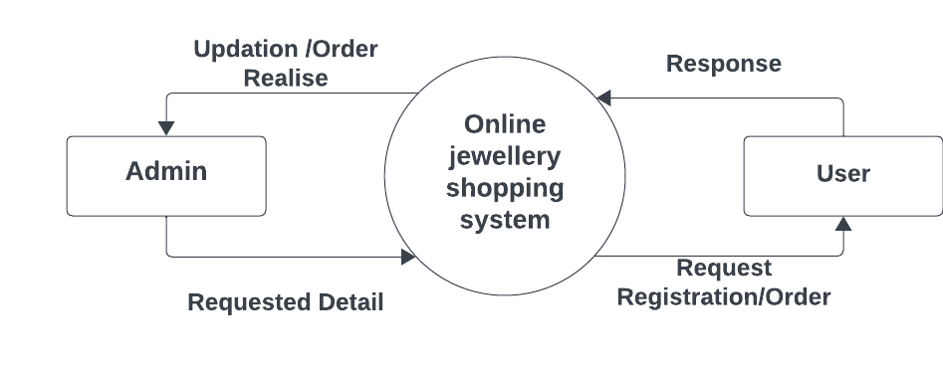
Data Flow diagram (DFD )
Context Level Diagram

Slide 7
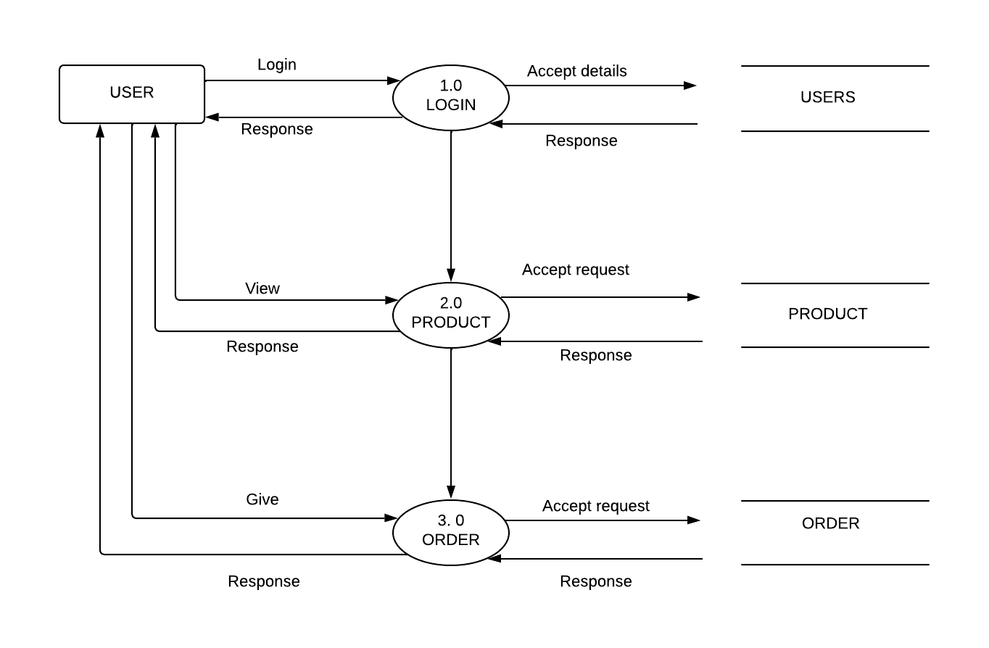
FIRST LEVEL FOR USER SIDE:

Slide 8
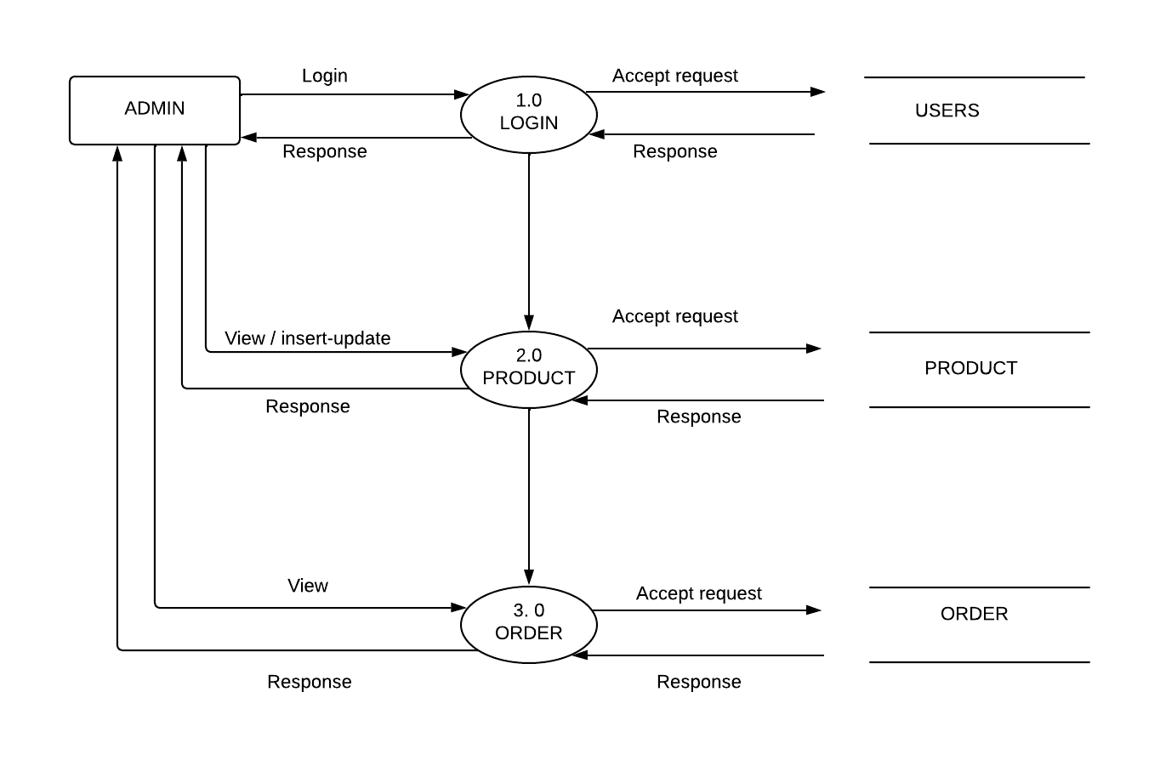
FIRST LEVEL DFD FOR ADMIN :

Slide 9
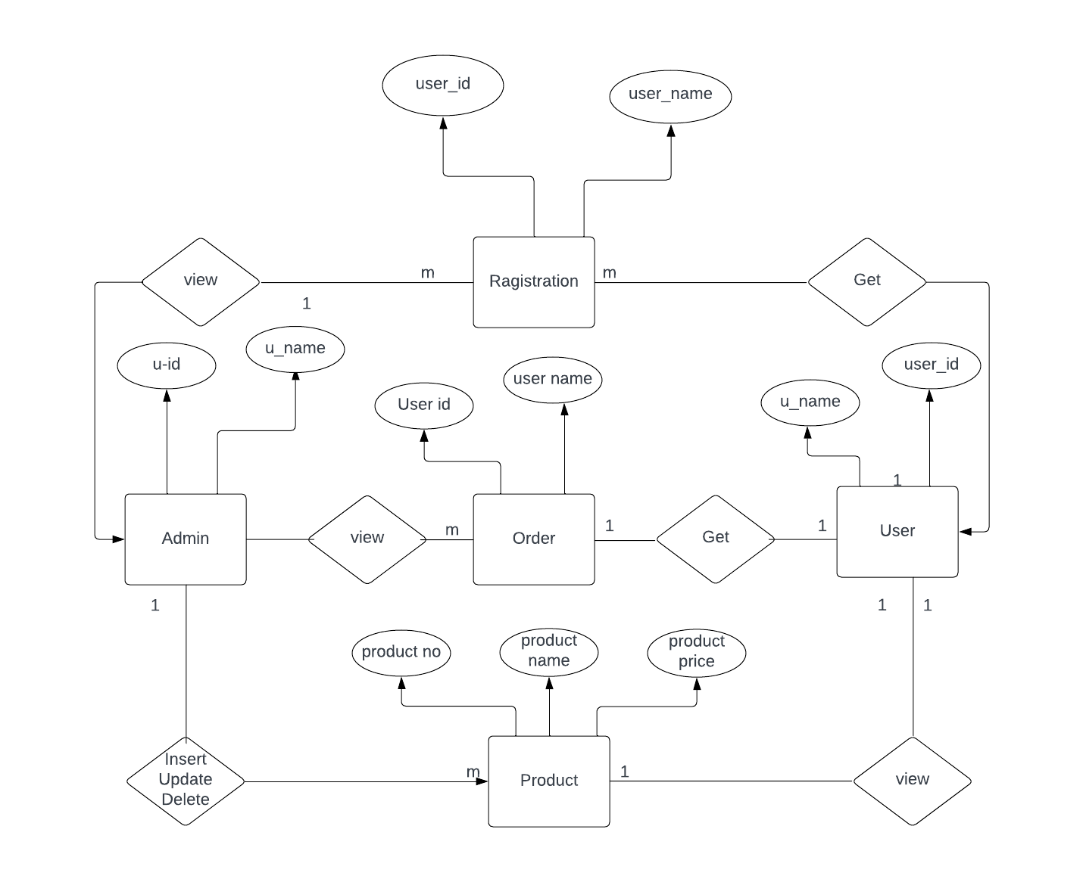
E-R DIGRAM:

Slide 10
USER TABLE:
Field Name | Field type | Size | Constraint | Description
id | Int | 11 | Primary key | Store id
fname | Varchar | 50 | Not null | Store fname
Lname | Varchar | 50 | Not null | Store lname
Address | Varchar | 100 | Not null | Store address
City | Varchar | 100 | Not null | Store city
Pin | Int | 6 | Not null | Store pin
email | Varchar | 100 | Not null | Store email
Password | Varchar | 15 | Not null | Stor pass
Type | Varchar | 20 | Not null | Store type

Slide 11
PRODUCT TABLE:
Field Name | Field type | Size | Constraint | Description
id | Int | 11 | Primary key | Store id
Product code | Varchar | 60 | Not null | Store product code
Product name | Varchar | 60 | Not null | Store product name
Product desc | Varchar | 70 | Not null | Store product details
Product img name | Varchar | 60 | Not null | Store product img
Qty | Int | 5 | Not null | Store quntity
Price | decimal | 10,2 | Not null | Store product price

Slide 12
ORDER TABLE:
Field Name | Field type | Size | Constraint | Description
id | Int | 15 | Primary key | Store id
Product code | Varchar | 50 | Not null | Store product code
Product name | Varchar | 50 | Not null | Store product name
Product desc | Varchar | 50 | Not null | Store product desc
Price | Int | 10 | Not null | Store price
Units | Int | 5 | Not null | Store units
Total | Int | 15 | Not null | Store total
Date | Timestamp |  | Not null | Store date
Email | Varchar | 50 | Not null | Store email

Slide 13
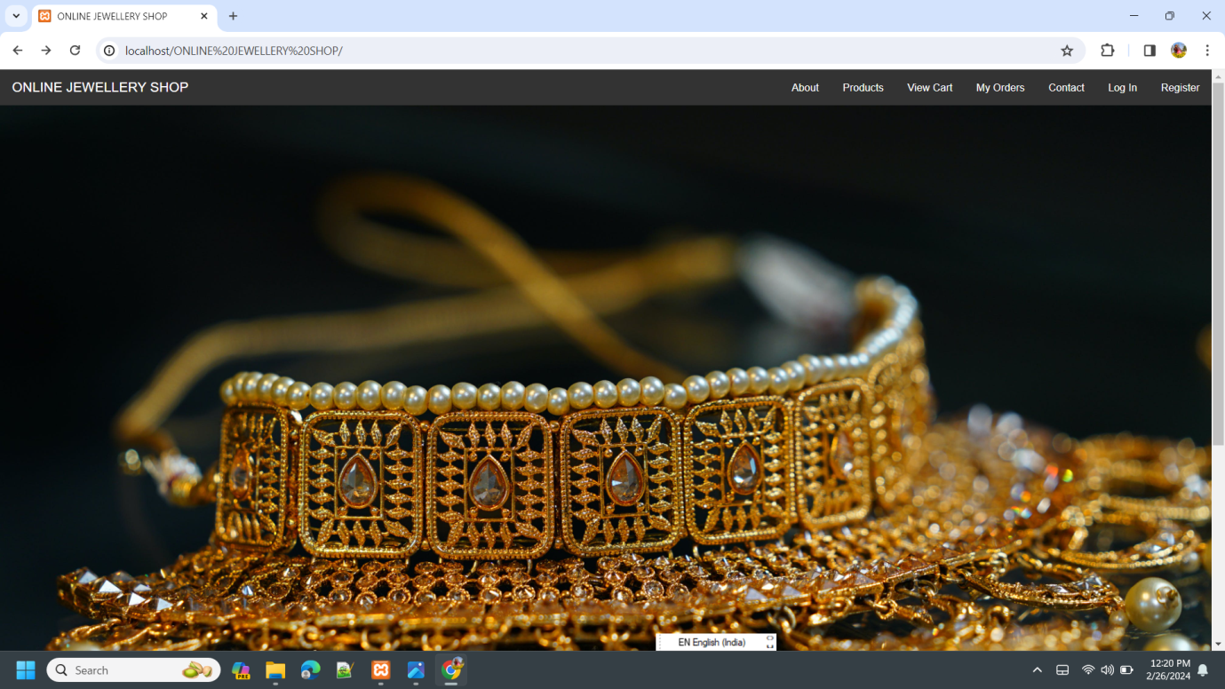
5.4 SCREEN SHOT 1.HOME PAGE:

Slide 14
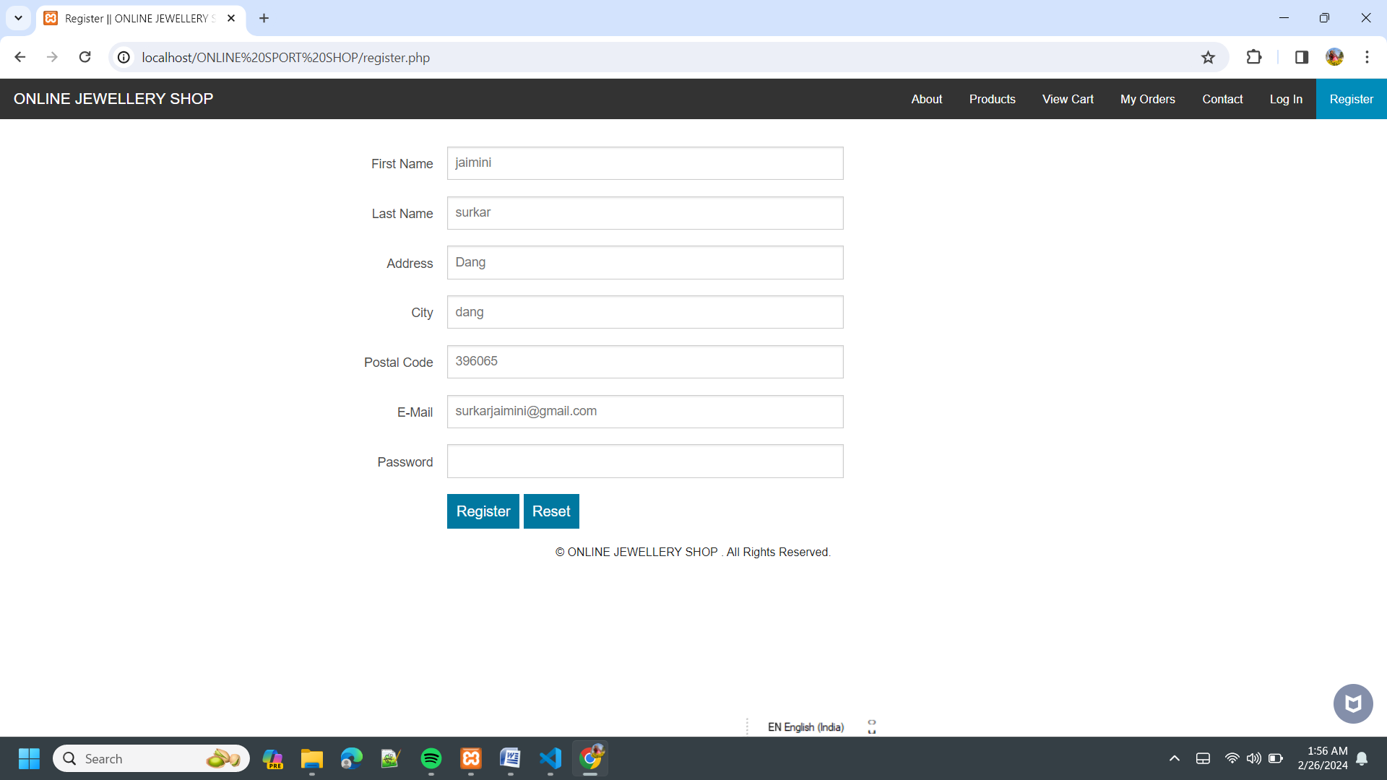
2. REGISTRATION PAGE :

Slide 15
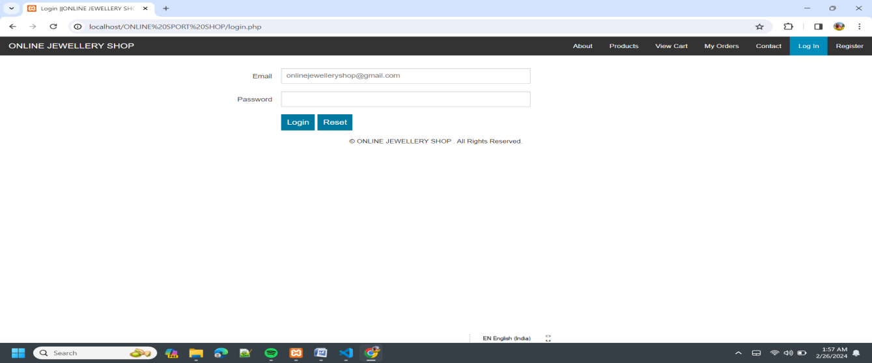
3.LOGIN PAGE :

Slide 16
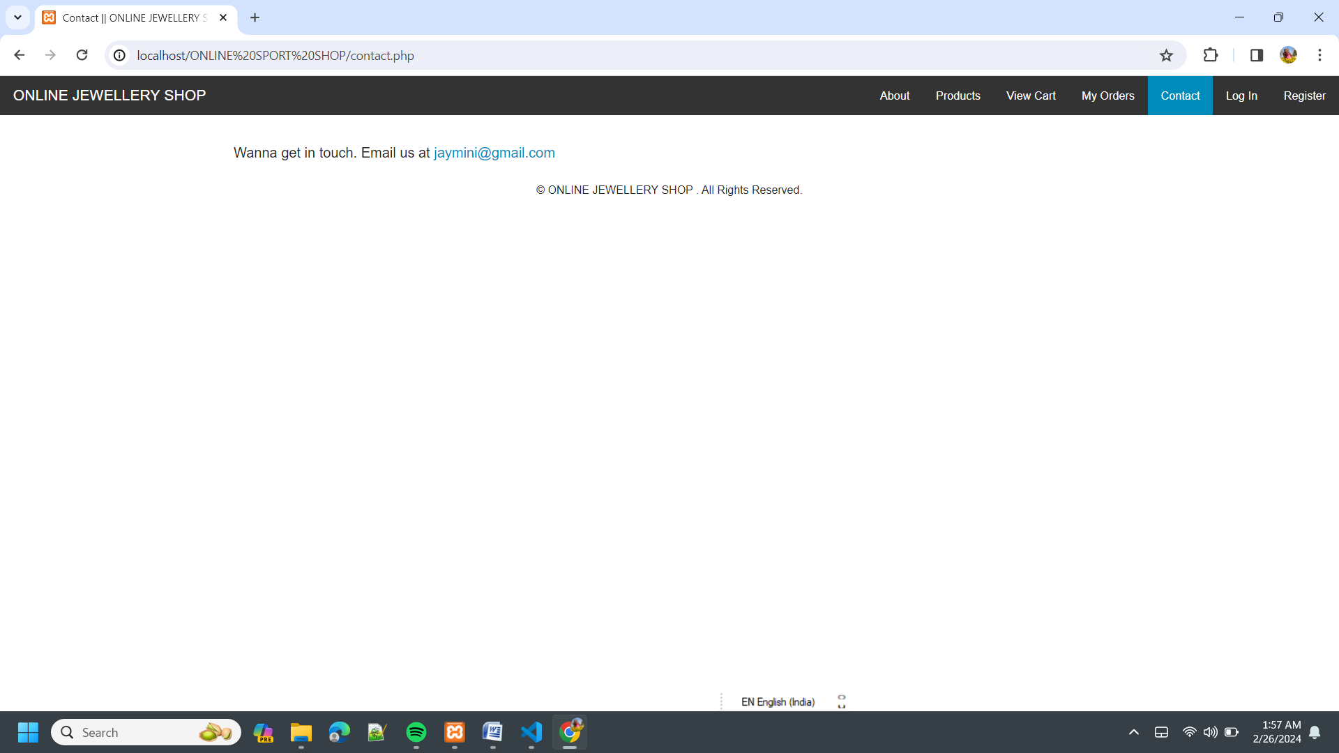
4. CONTACT PAGE :

Slide 17
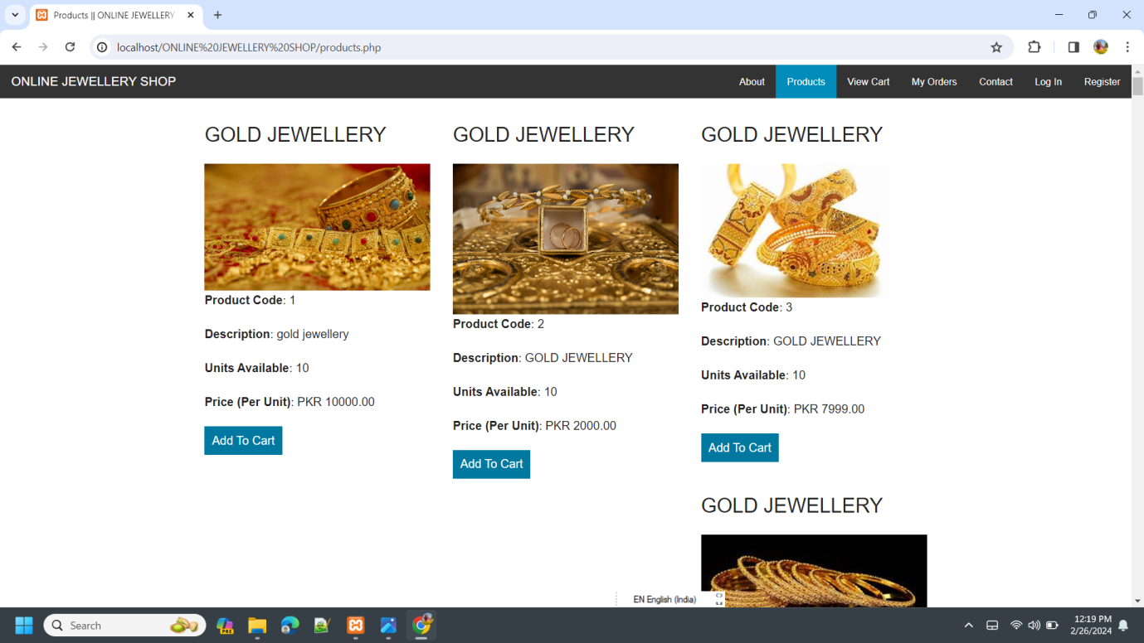
5. PRODUCT PAGE :

Slide 18
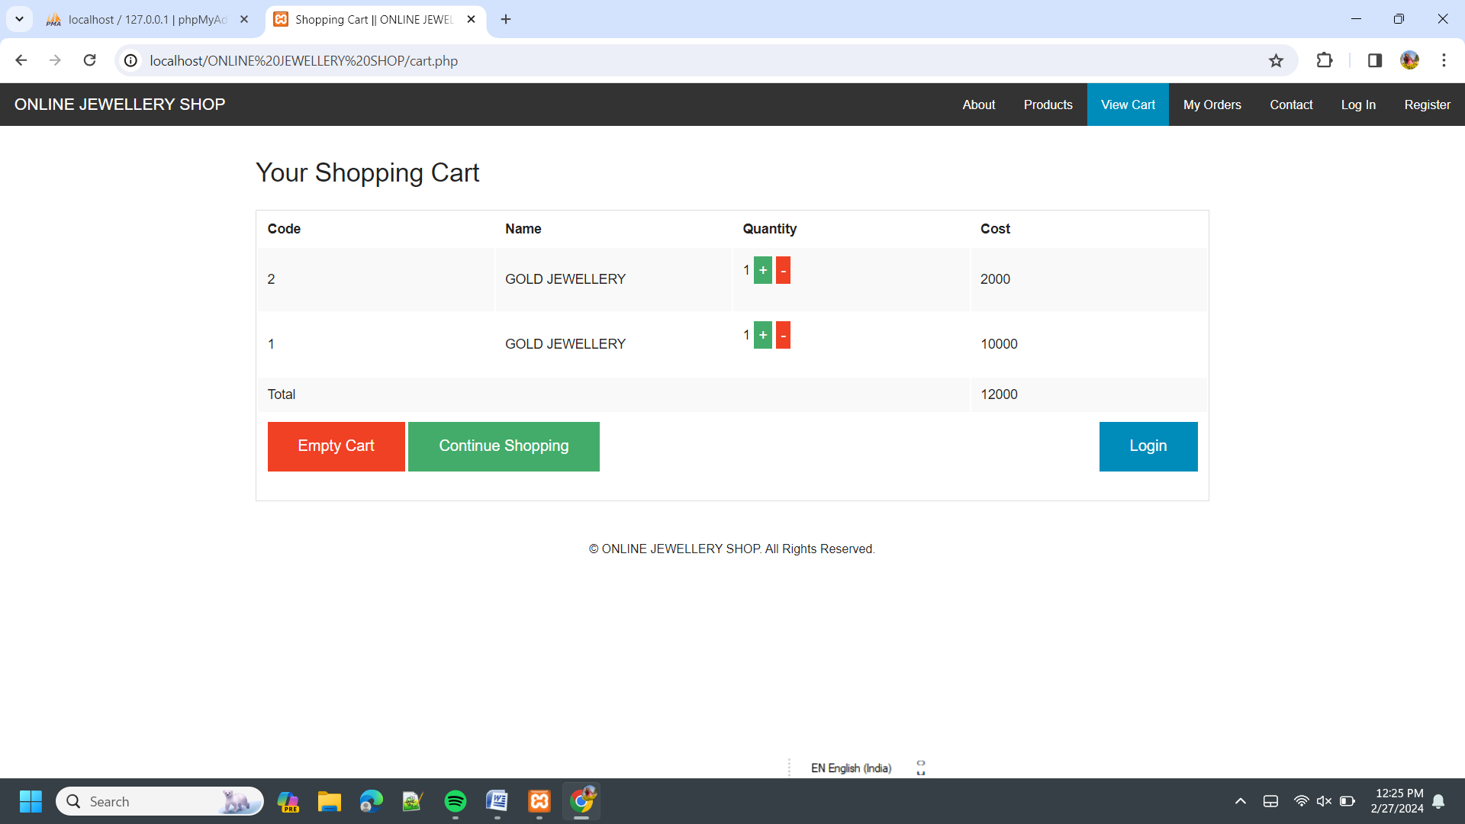
6.View cart

